Slide 2
Want to make a cutting edge data platform using Kusto in Fabric?
Then come along for a journey into the world and wonders of Kusto and the new Streamevent service in Fabric.
In this session I will guide you through the experience and close collaboration between Fabric and the Kusto database and querysets.
Along with how to help Power BI get the most out of your Kusto database with small tweeks.
Springled with a bit of new magic in the Jupiter Notebooks for the Kusto language, we will also set a course towards how the data engineer can begin to leverage the Kusto service.
After watching this level 200 session I hope you'll have found inspiration to work with the Kusto service in Fabric and know how to give the Kusto engine the small push it needs to perform the best in close collabaration with Power BI.
Topics:
- Kusto database
- Kusto Queryset
- Kusto magic (%kql)
- Power BI
- Streamevent

Slide 3









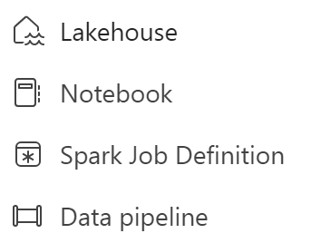










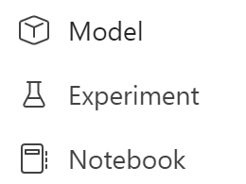


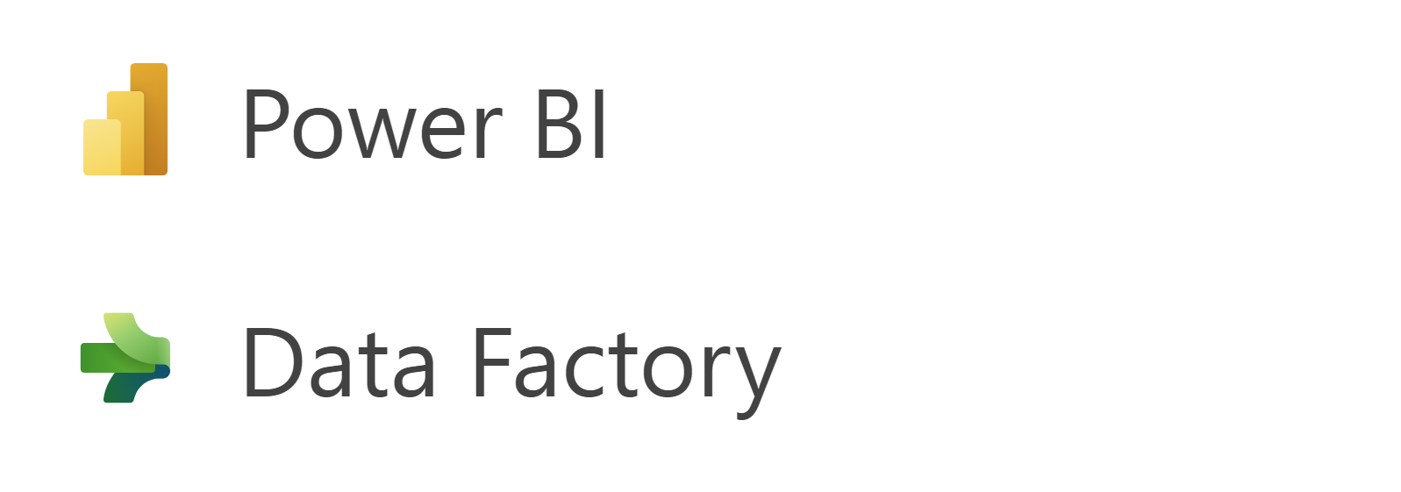

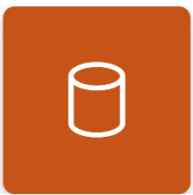

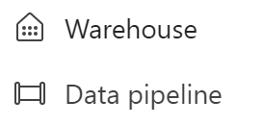

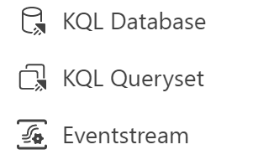


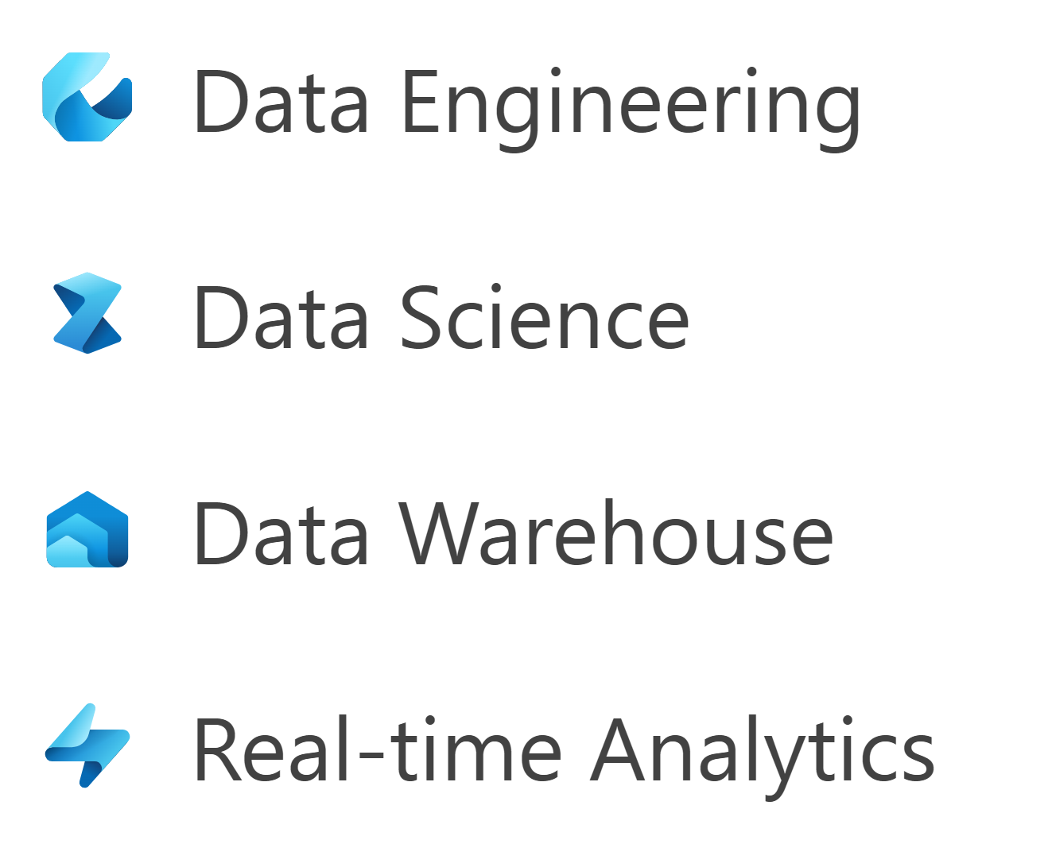

























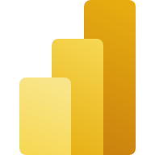







D
D
Data Factory
Data Factory

Slide 4





The Kusto experience in Fabric

Slide 5






Brian Bønk Rueløkke
Principal & Enterprise architect, Data & AI
Fellowmind
Want to link up
Read my thoughts
Download the slides and code
https://linkedin.com/in/brianbonk
https://brianbonk.dk
https://github.com/brianbonk
FastTrack Recognized Solution Architect
Power BI
2022 >>
Certified Trainer
Data Platform
2018 >>

Slide 6



A unified analytics solution for the era of AI
The Kusto experience in Fabric

Slide 7
A unified analytics solution for the era of AI
Real-Time Analytics at scale in Fabric

Slide 8
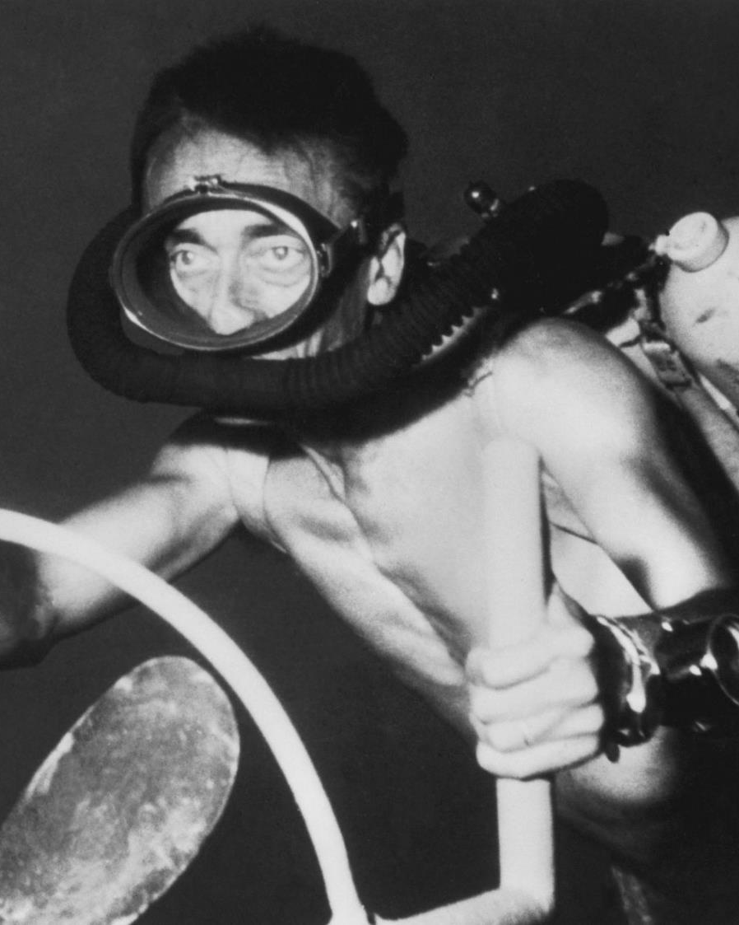
Jaques Cousteau
1910-1997

Slide 9
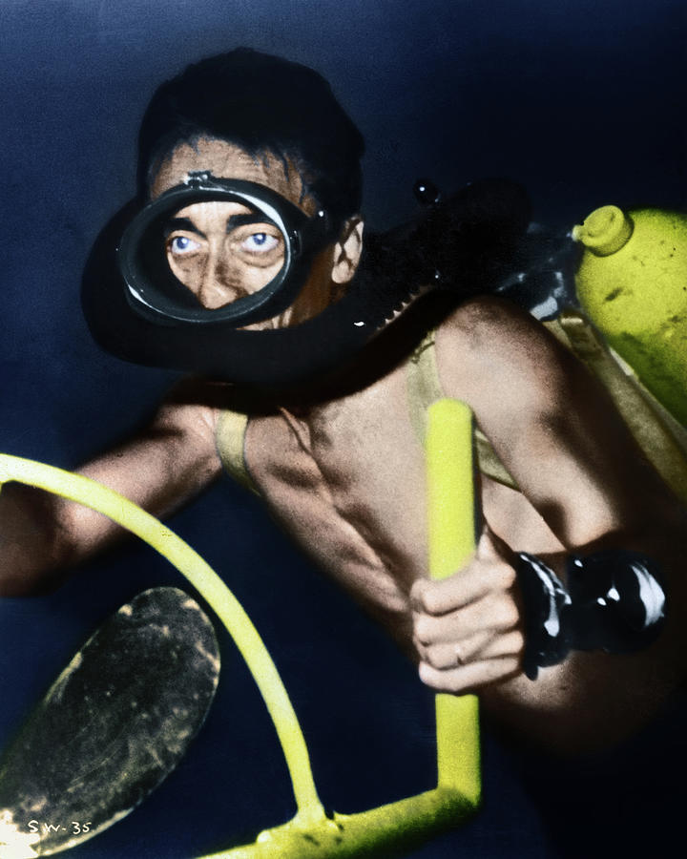
Jaques Cousteau
1910-1997

Slide 10

It all starts with data

Slide 11

Telemetry – a key data for digital transformation
It all starts with data
IoT
Smart factories
Events
Smart buildings
Click stream
Connected devices
SIEM
Time series
Security
Logs
Historians

Slide 12
Telemetry – a key data for digital transformation
IoT
Smart factories
Events
Smart buildings
Click stream
Connected devices
SIEM
Time series
Security
Logs
Historians

Slide 13
Telemetry – a key data for digital transformation
75B
IoT
90ZB
Smart factories
Events
Connected devices by 2025
Total amount of telemetry data by 2025
Smart buildings
Click stream
Connected devices
SIEM
Time series
Security
Logs
Historians

Slide 14

Microsoft Fabric
Data Factory
Synapse Data Engineering
Synapse Data Warehouse
Synapse Data Science
Synapse Real-Time Analytics
Power BI
Data Activator (coming soon)
OneLake

Slide 15
Microsoft Fabric
Data Factory
Synapse Data Engineering
Synapse Data Warehouse
Synapse Data Science
Synapse Real-Time Analytics
Power BI
Data Activator (coming soon)
OneLake

Slide 16

Digital transformation
Cybersecurity
Asset tracking and management
Predictive maintenance
Supply chain optimization
Customer experience
Energy management
Inventory management
Quality control
Environmental monitoring
Fleet management
Health and safety

Slide 17
Fabric Real-time Analytics solution enables organizations to consume vast amount of data, focus and scale up their Analytics solution with data in motion, empower their business analysts, and democratize their data for citizen data scientists and Data Engineers
Synapse Real-Time Analytics

Slide 18
Unlimited Scale
(query, ingestion
and storage)
Any data source
Any data format
KQL database
Key capabilities
Structured
Semi-structured
Free-text
Real-time transformation og complicated data strcutures
Streaming analytics in Near-Real-Time
High performance
Low latency
High freshness
Timeseries database
Everything is indexed and partitioned

Slide 19












Real-Time Analytics
Data store
Ingestion
Store
Expose
Lakehouse & Warehouse
CI & Shortcuts
Kusto DB
Power BI
Structured / Unstructured
Pipeline & Dataflows
Kusto queryset
Event Streaming
Lakehouse & Warehouse
Notebook
Mirror
ML Model

Slide 20

Get started for free
https://dataexplorer.azure.com/freecluster
https://detective.kusto.io

Slide 21
Kusto in Power BI
Forget everything you know about
query performance vs data types
&
data modelling best practices

Slide 22
Data modelling Kusto in Power BI
Single table reporting can be a good option, if you can include all columns from dimensions to the table
M:M relations are hard to avoid, but not a big deal → all queries will be translated to KQL
All dimensions must be tagged with “IsDimension=true”
Dimensions can be imported if they are <1 mio rows.
INTEGER and DECIMAL er slow joins compared to STRING

Slide 23

Harness the Power (BI) of Kusto
Let Power BI build the KQL
In Power Query
Using DAX
Or build a Kusto function

Slide 24

DEMO
Live coding
(hopefully no demo-ghost 👻)

Slide 25

Harness the Power (BI) of Kusto
.create-or-alter function GetSysLogs(TimeWindow:string , Bucket:string )
{
cluster('help').database('SampleLogs').RawSysLogs
| where timestamp > ago(totimespan(TimeWindow))
| summarize LogCount=count() by name, bin(timestamp, totimespan(Bucket))
| order by timestamp asc
}
GetSysLogs('5d','1h')

Slide 26



Feedback
Brian Bønk Rueløkke
Principal & Enterprise architect, Data & AI
Fellowmind
https://linkedin.com/in/brianbonk
https://brianbonk.dk
https://github.com/brianbonk
FastTrack Recognized Solution Architect
Power BI
2022 >>
Certified Trainer
Data Platform
2018 >>
https://linkedin.com/in/brianbonk

